Slide 1

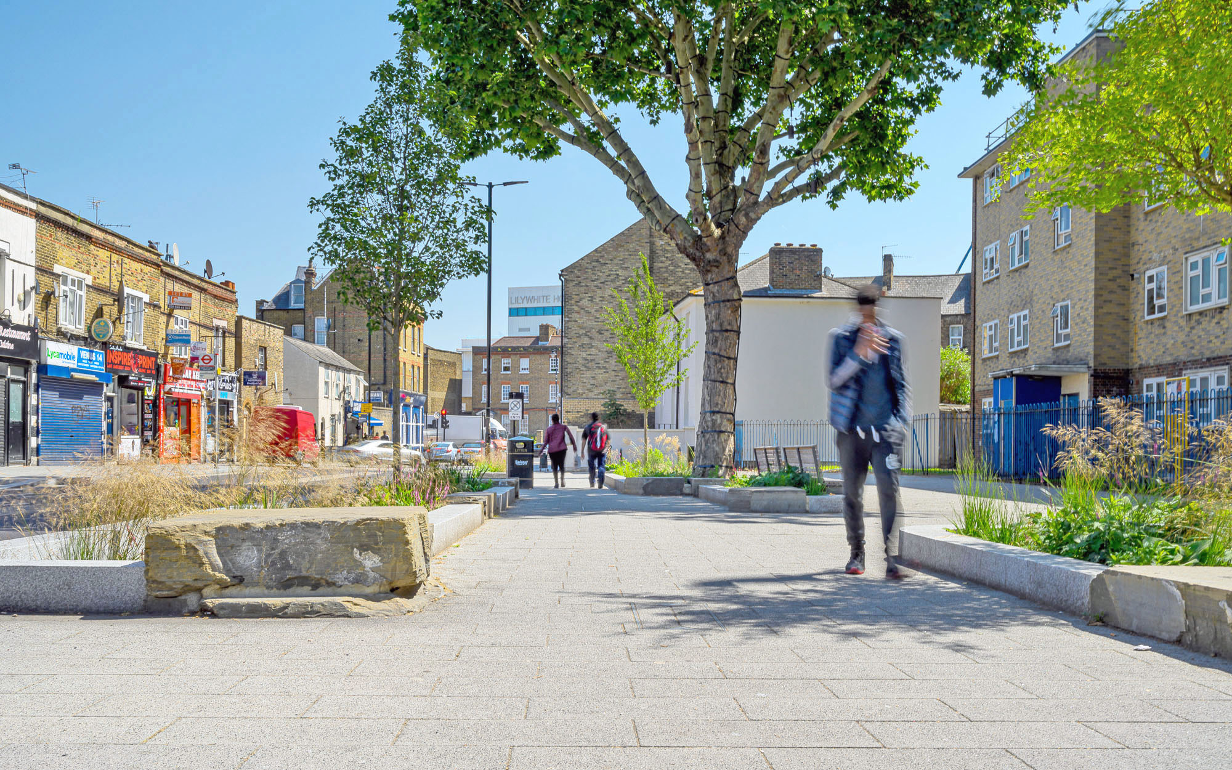
Integrating
Street Trees, SuDS and
Hard Landscapes
Presented by Bob Bray

Slide 2
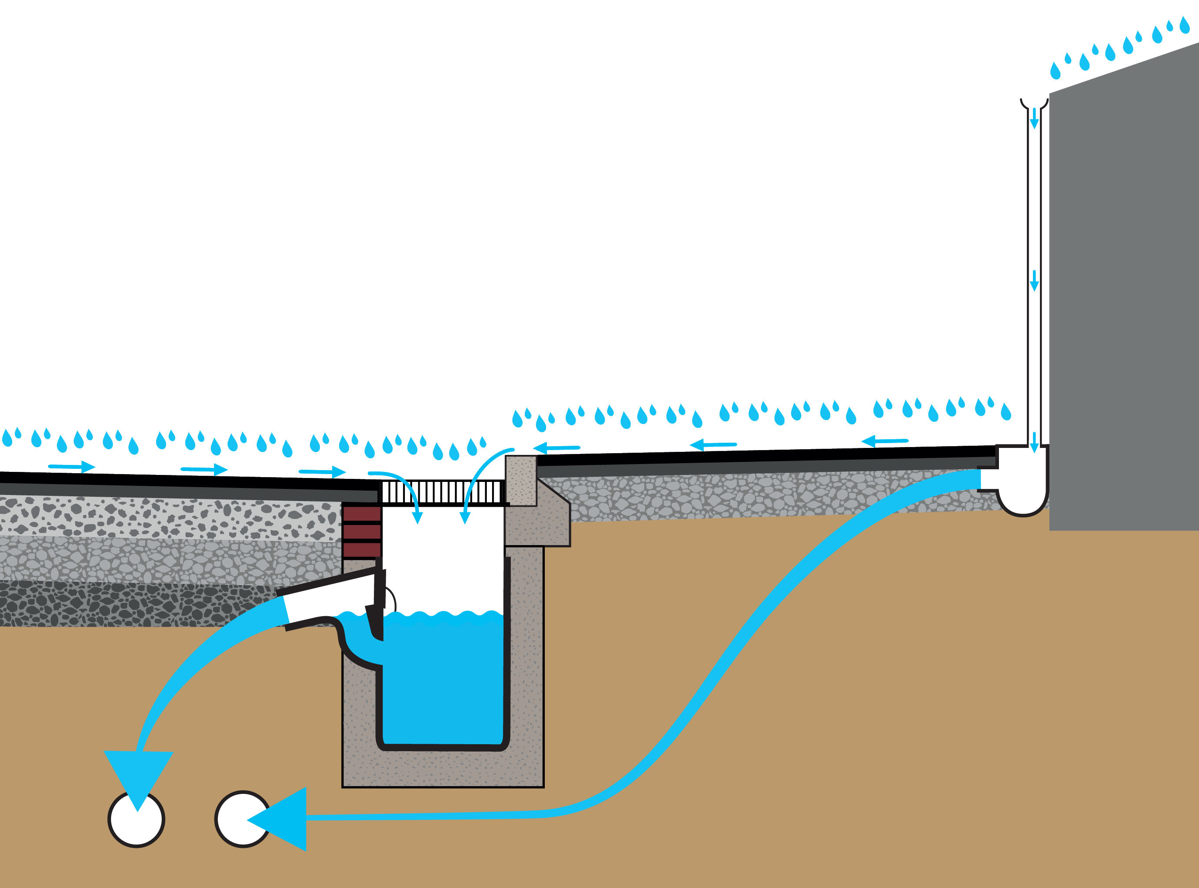
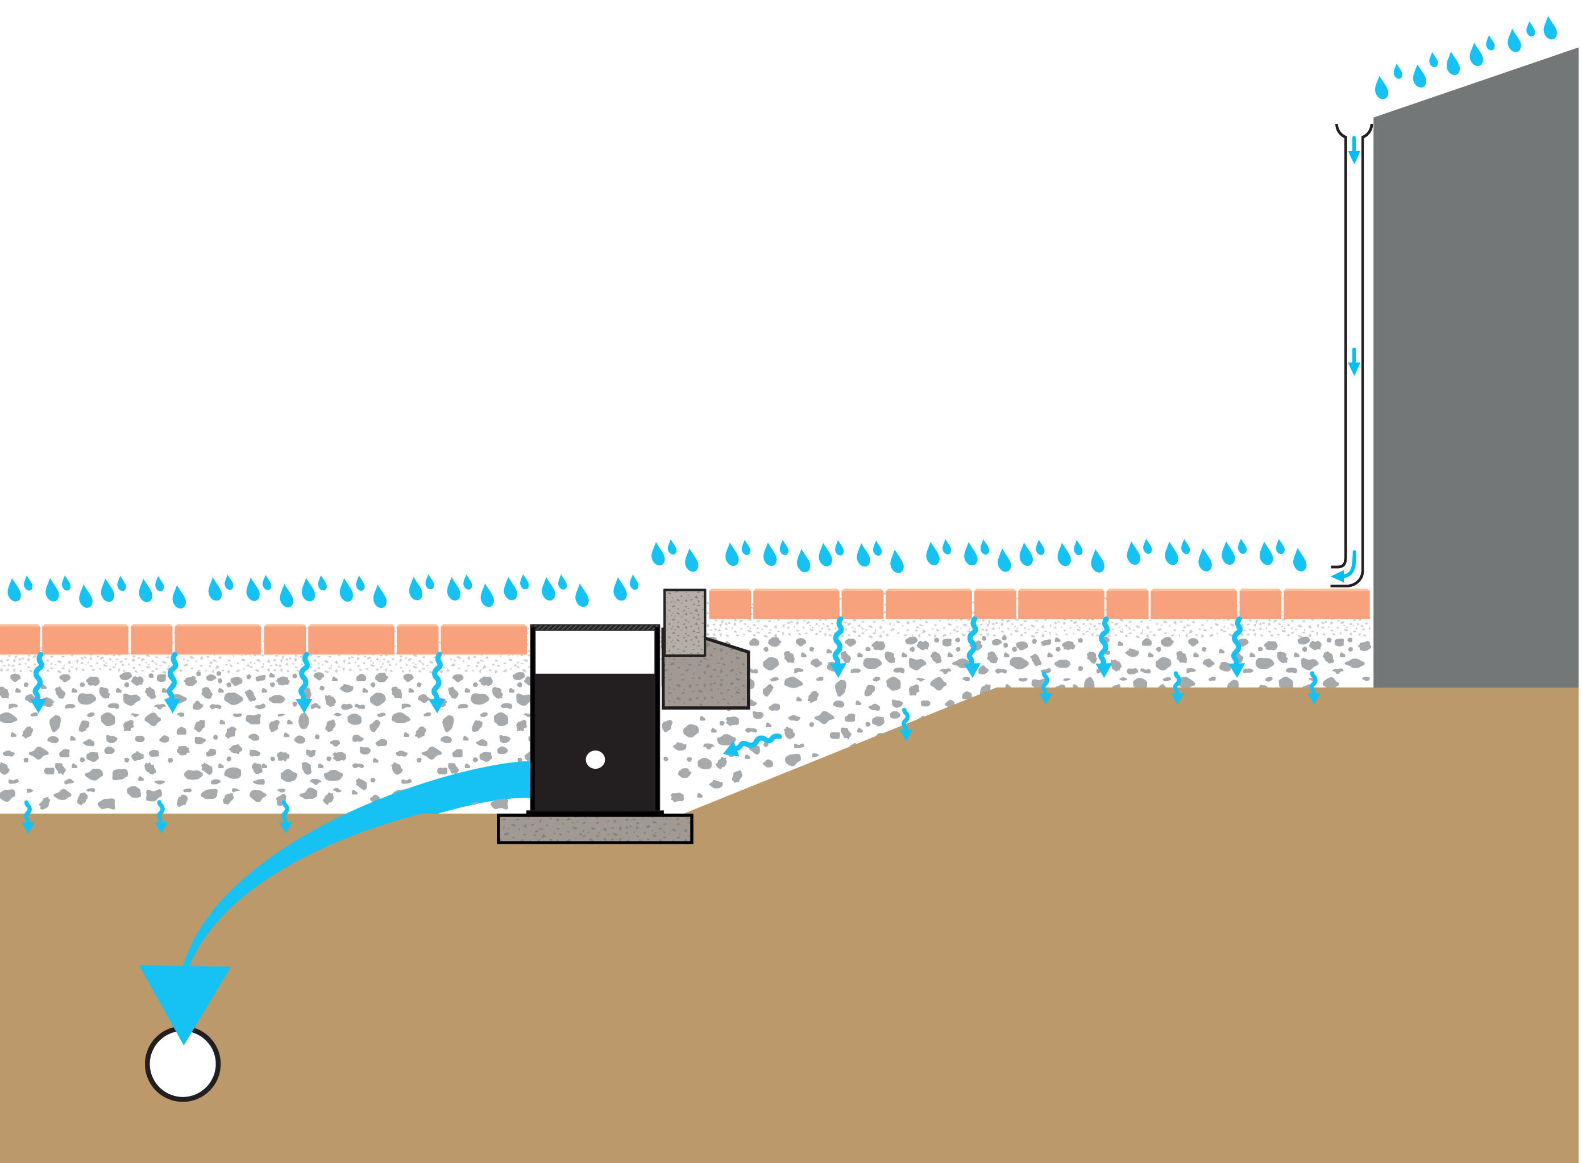
Integrating Street Trees, SuDS and Hard Landscapes
The modern city is bigger, more complex and requires higher levels of service from paved surfaces than in the past.
  It should continue to meet the existing needs of vehicles and pedestrians.
  It should recognise new requirements driven by climate change – rainfall management with SuDS and urban cooling through green infrastructure.
  It should use new techniques to create the ‘permeable city’.
Traditional piped drainage – a sealed surface
Permeable surface drainage
– water, air and gas exchange

Slide 3
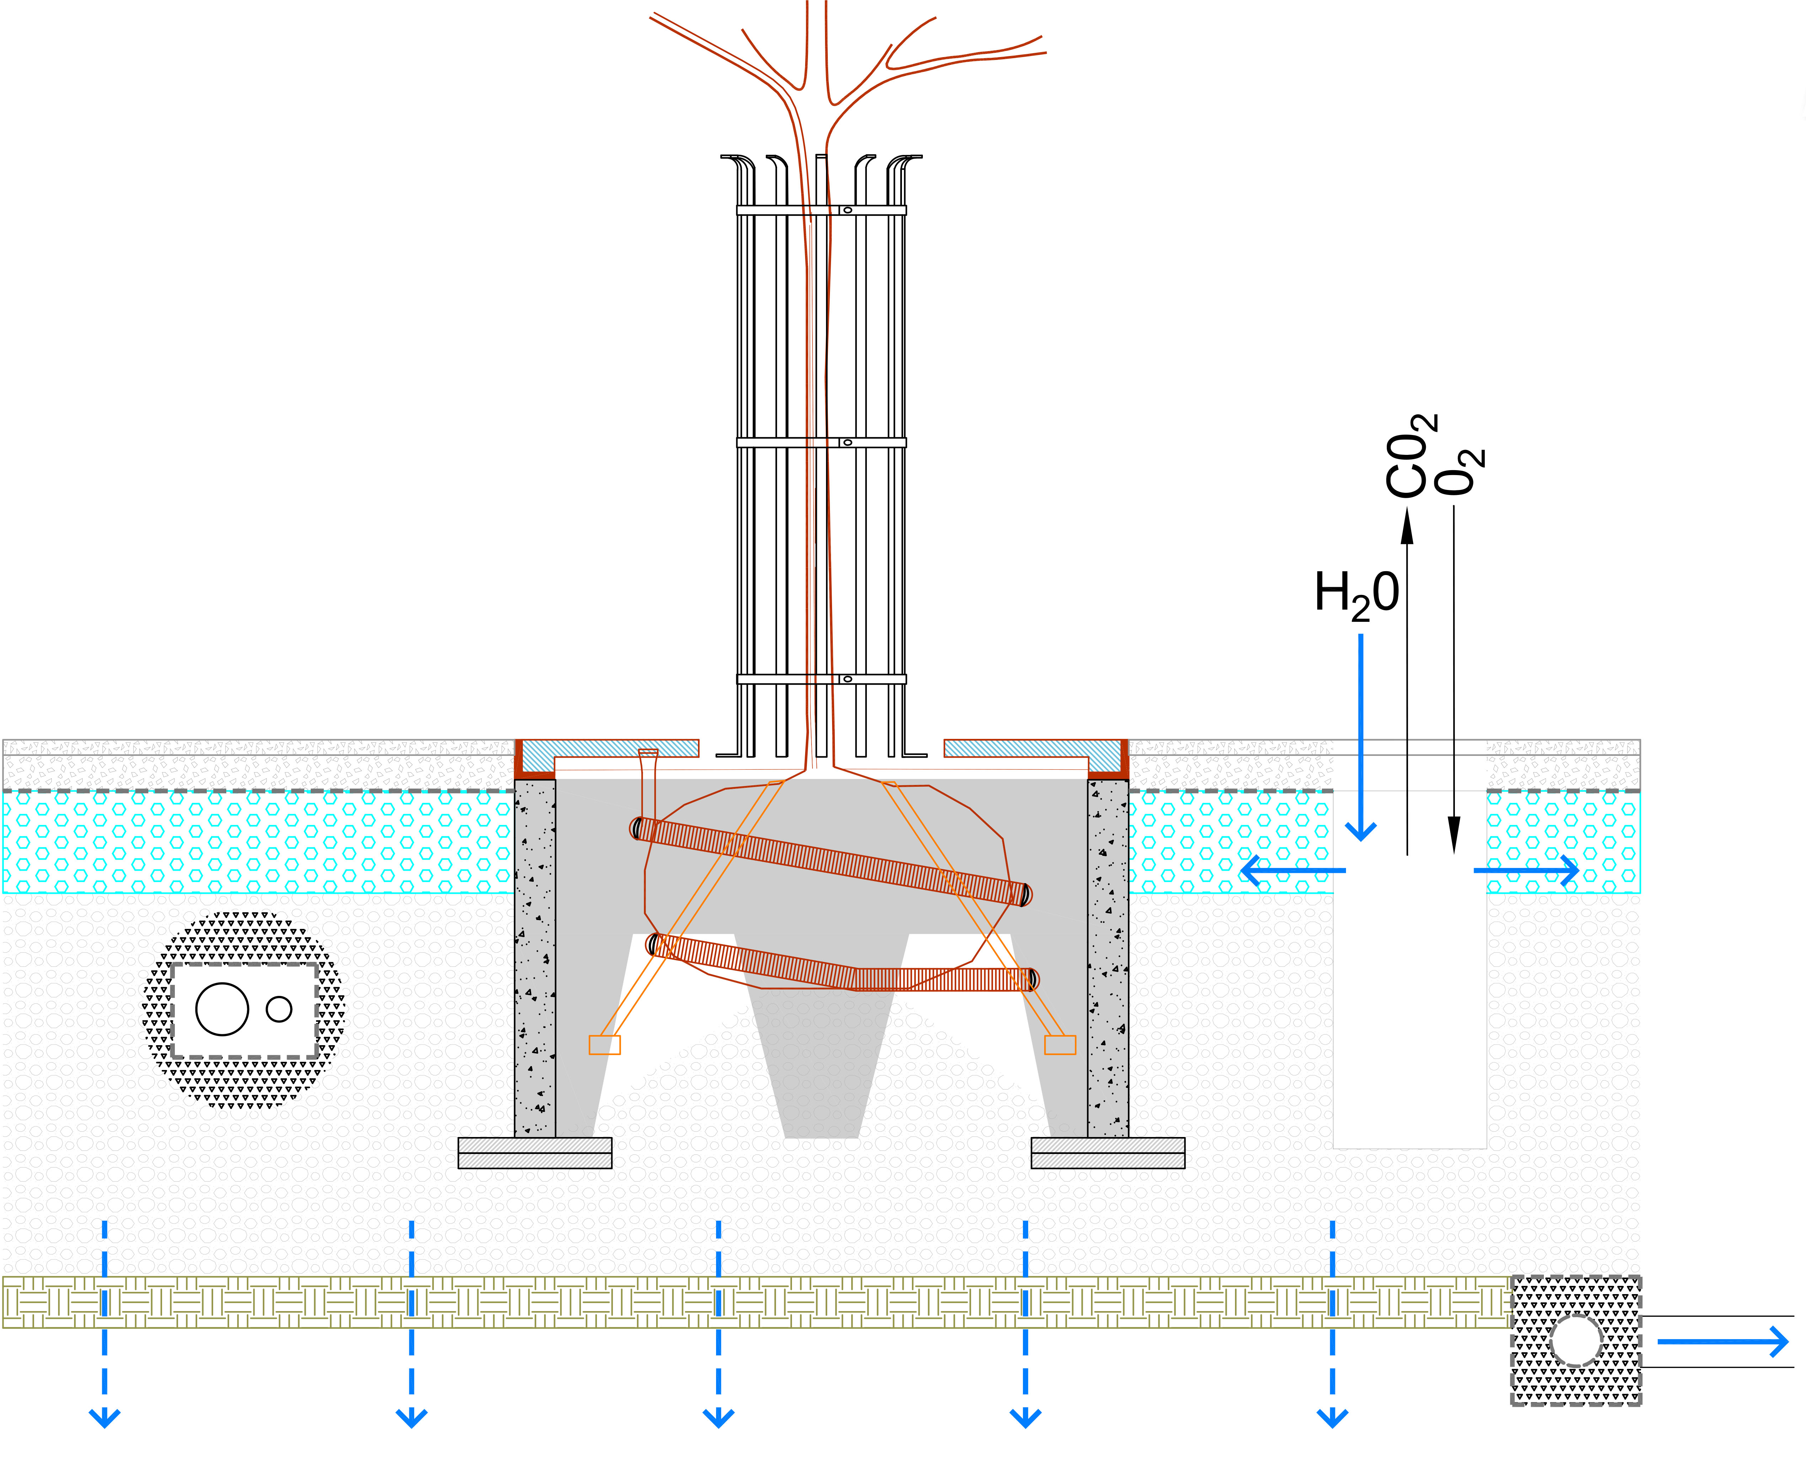
Integrating Street Trees, SuDS and Hard Landscapes
Urban trees and green infrastructure are being transformed by new urban tree soil design enabling root space, gas exchange and water for growth.
  The ‘Stockholm’ crushed rock support for tree growth is one approach.
  The ‘tree cell’ support for tree growth is another approach.
  BUT essential opportunities to make this happen are being missed by not using permeable surfaces.

Slide 4
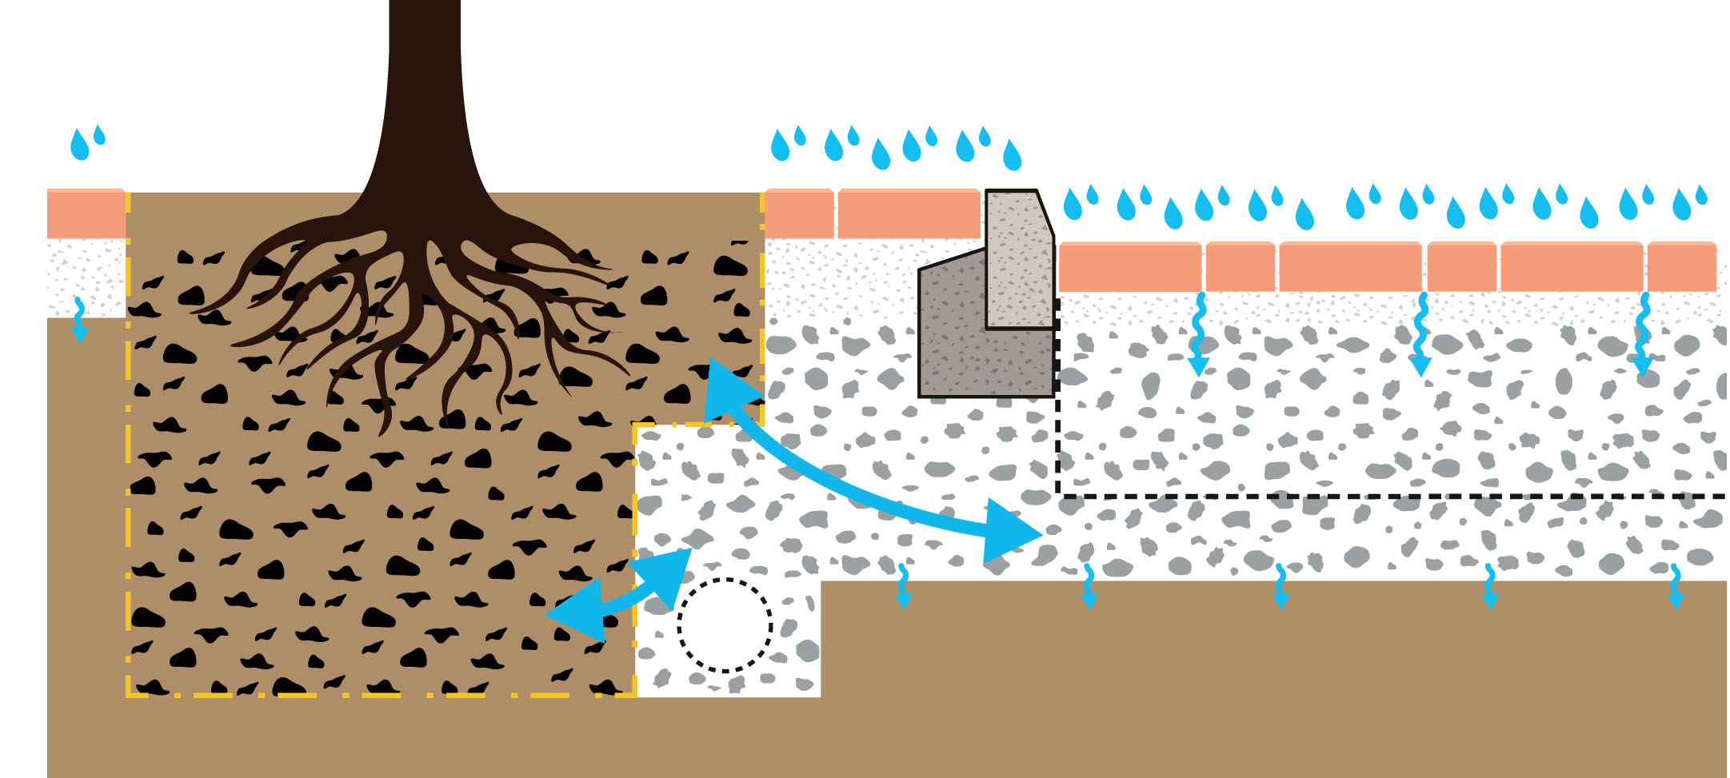
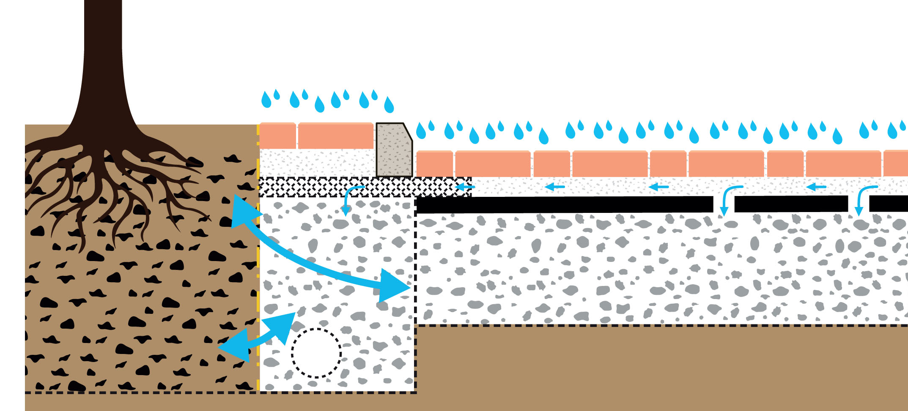
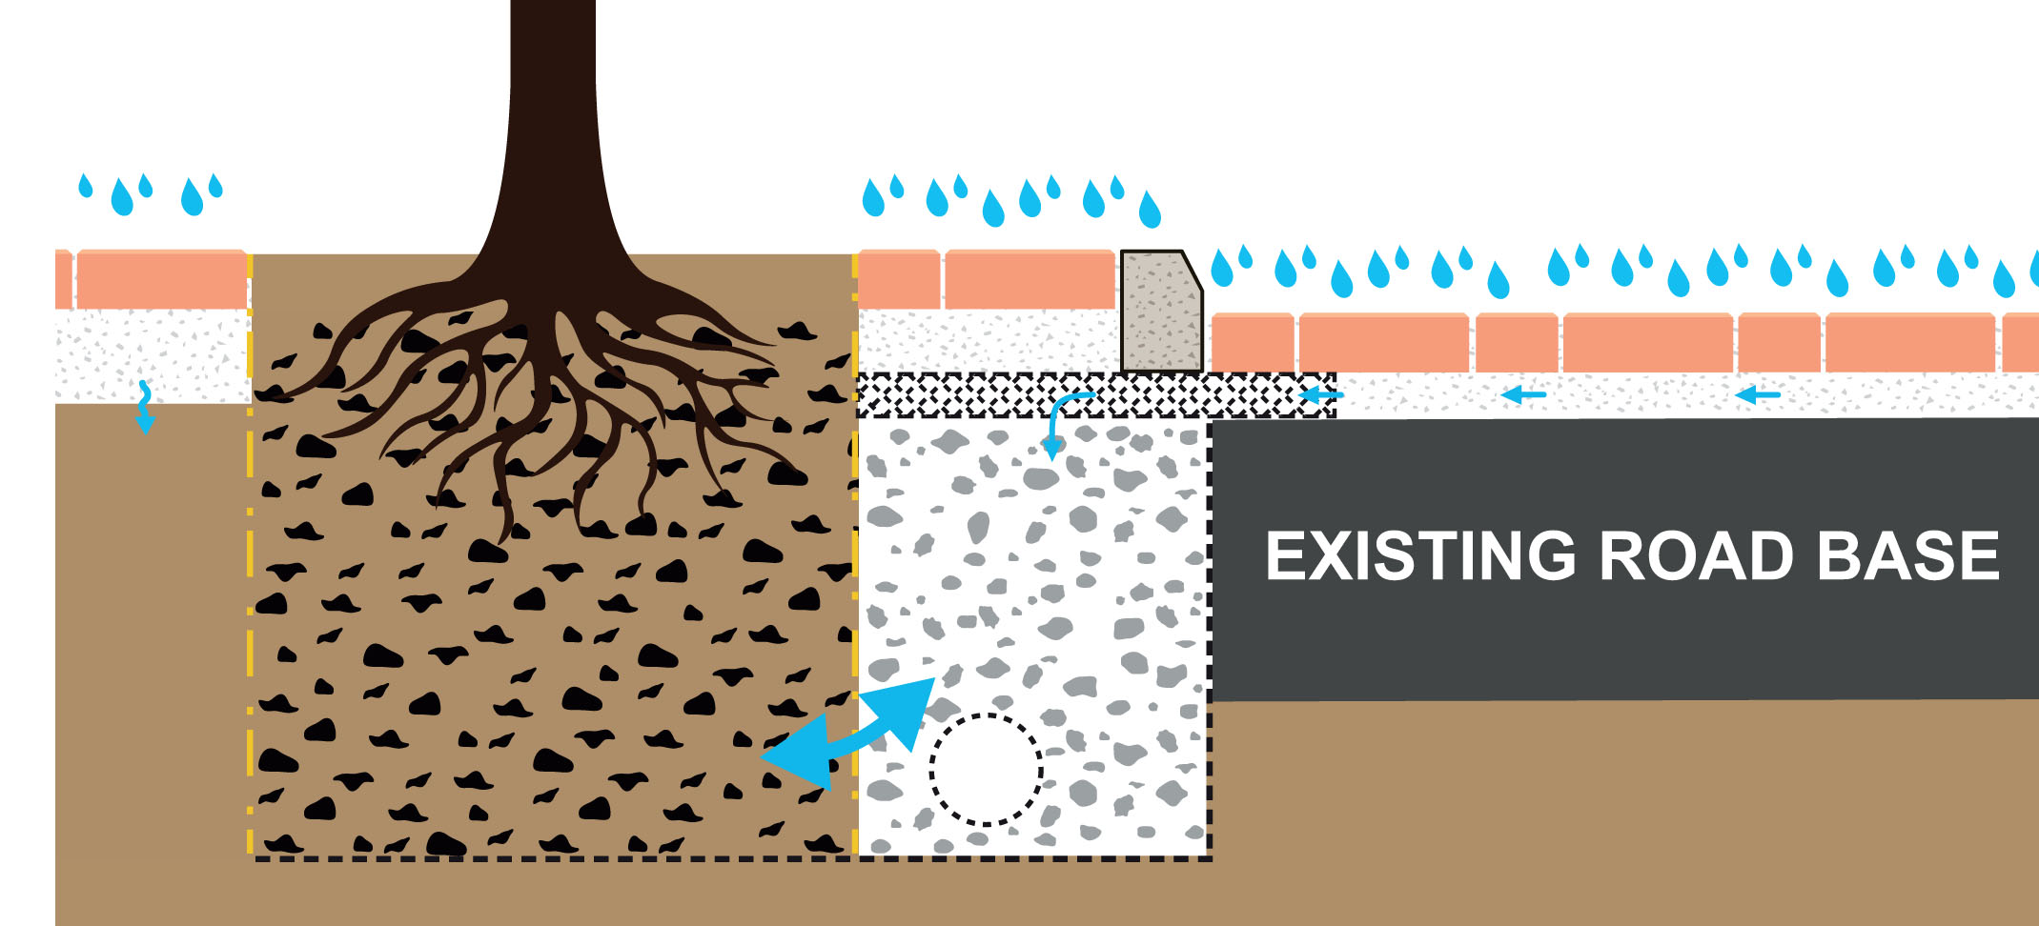
Integrating Street Trees, SuDS and Hard Landscapes
Rainfall management should use adjacent permeable surfaces to enable passive watering and gas exchange for trees, and to deliver SuDS.
  Rainfall is managed where it falls to clean and store water ‘at source’.
  A full permeable profile manages rainfall on new development with SuDS storage
  An ‘overlay’ profile is a recent technique for retrofit and asset renewal.

Slide 5
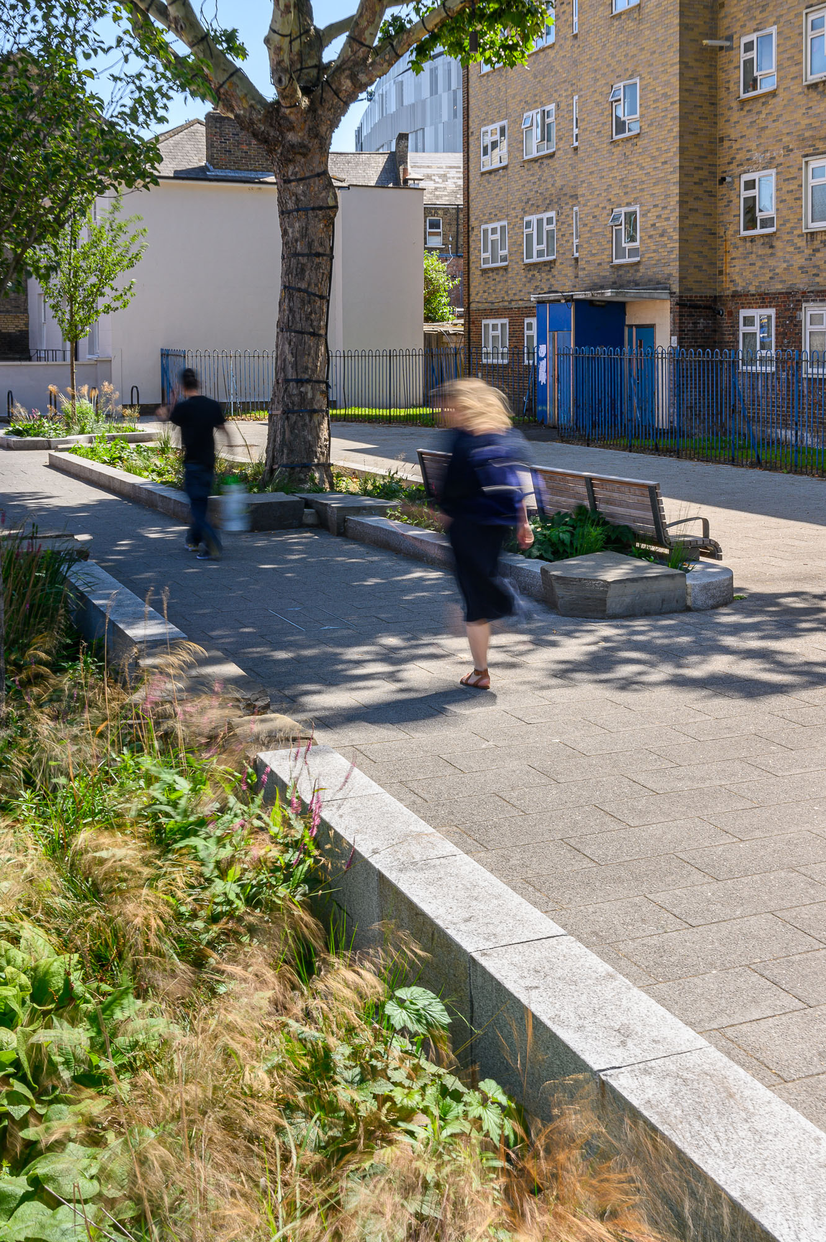
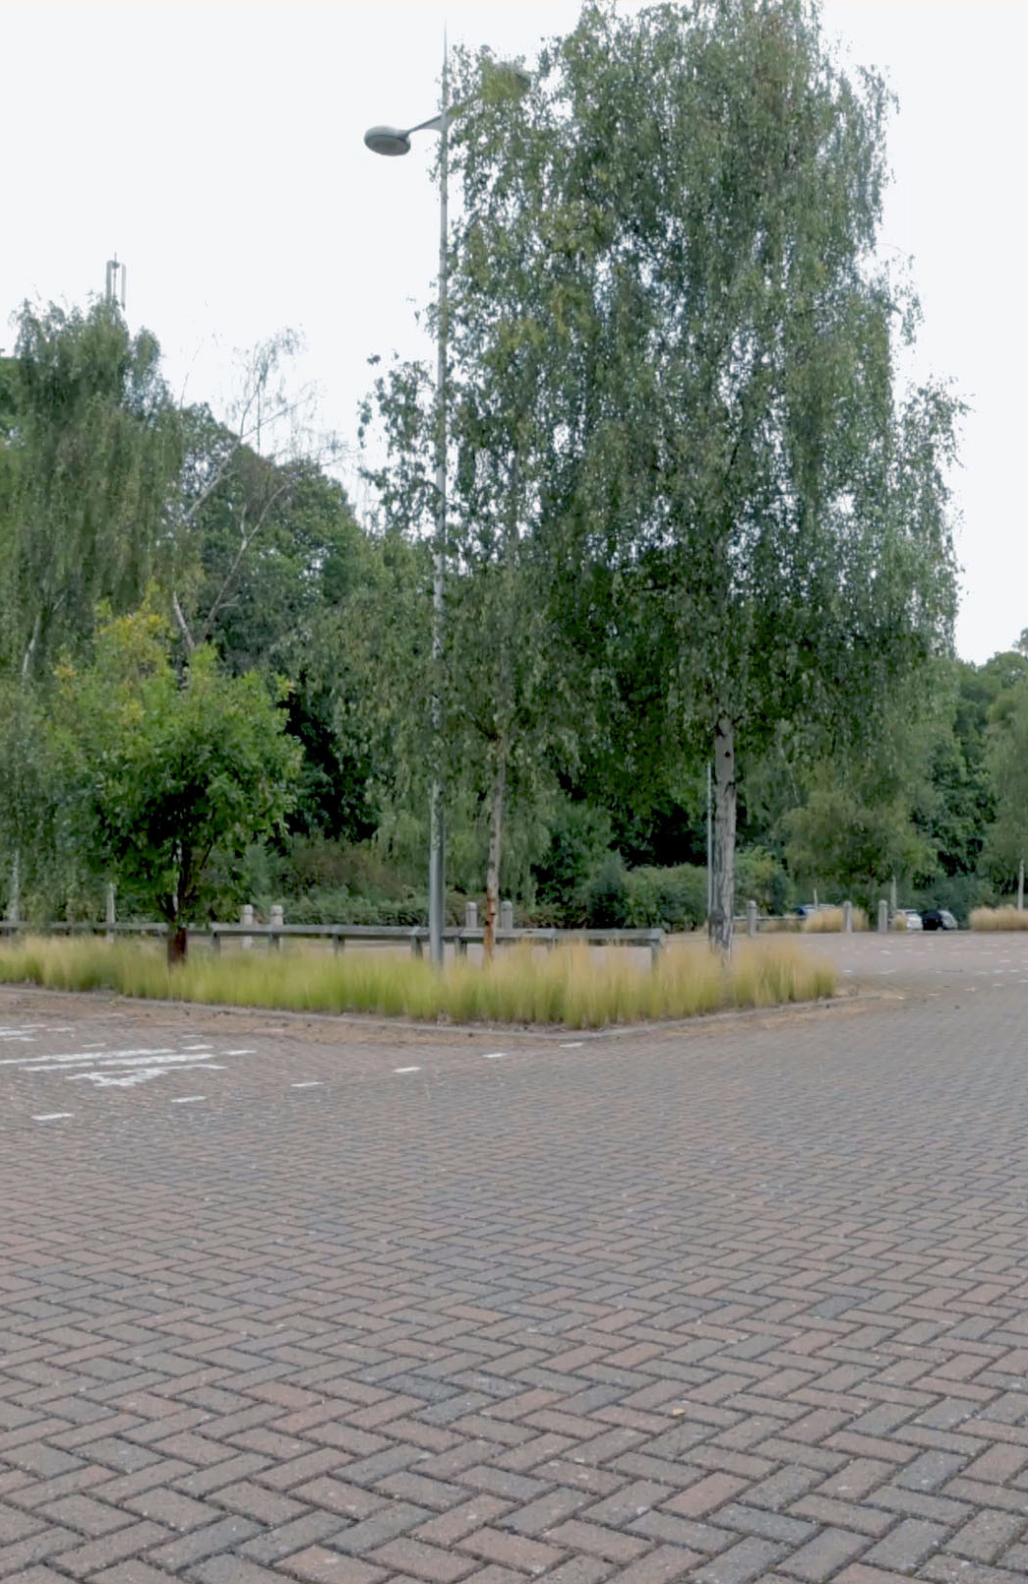
Integrating Street Trees, SuDS and Hard Landscapes
Concrete block permeable paving has been proven over 25 years as a key multifunctional SuDS component.
  Durable long-life high-strength blocks suitable for all low-speed urban traffic
  Reusable after services access or for layout changes
  Avoiding root disruption to paving surface
  Silt and pollution managed at the surface
  Fully compatible with tree-pits, structural soils and bioretention planters.
Martlesham Park & Ride 18 years after completion

Slide 6
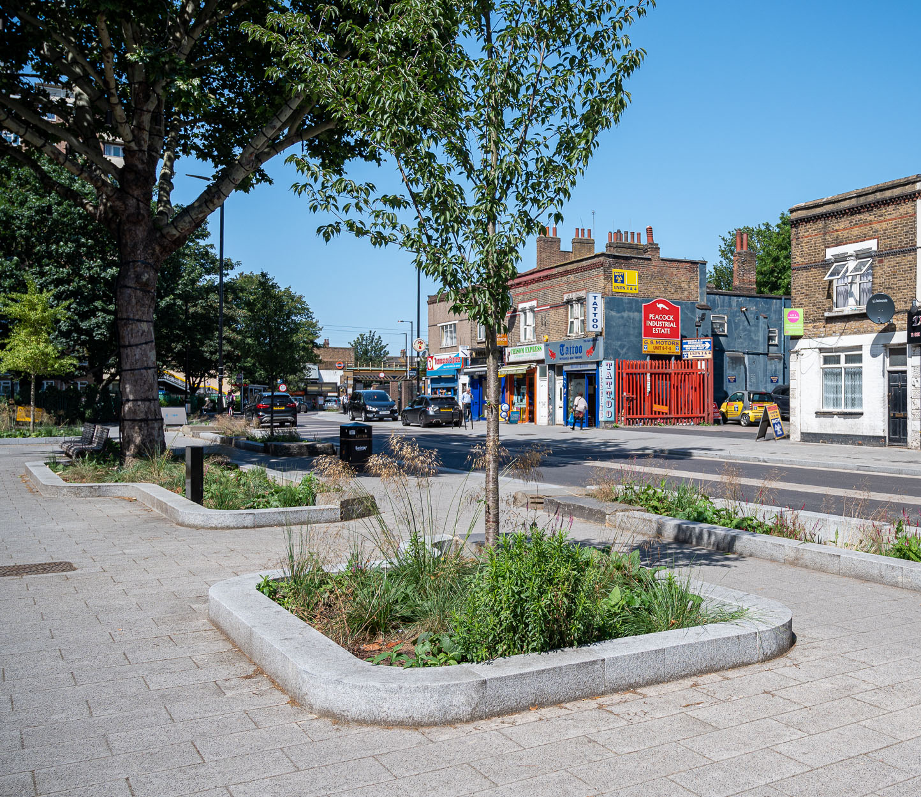
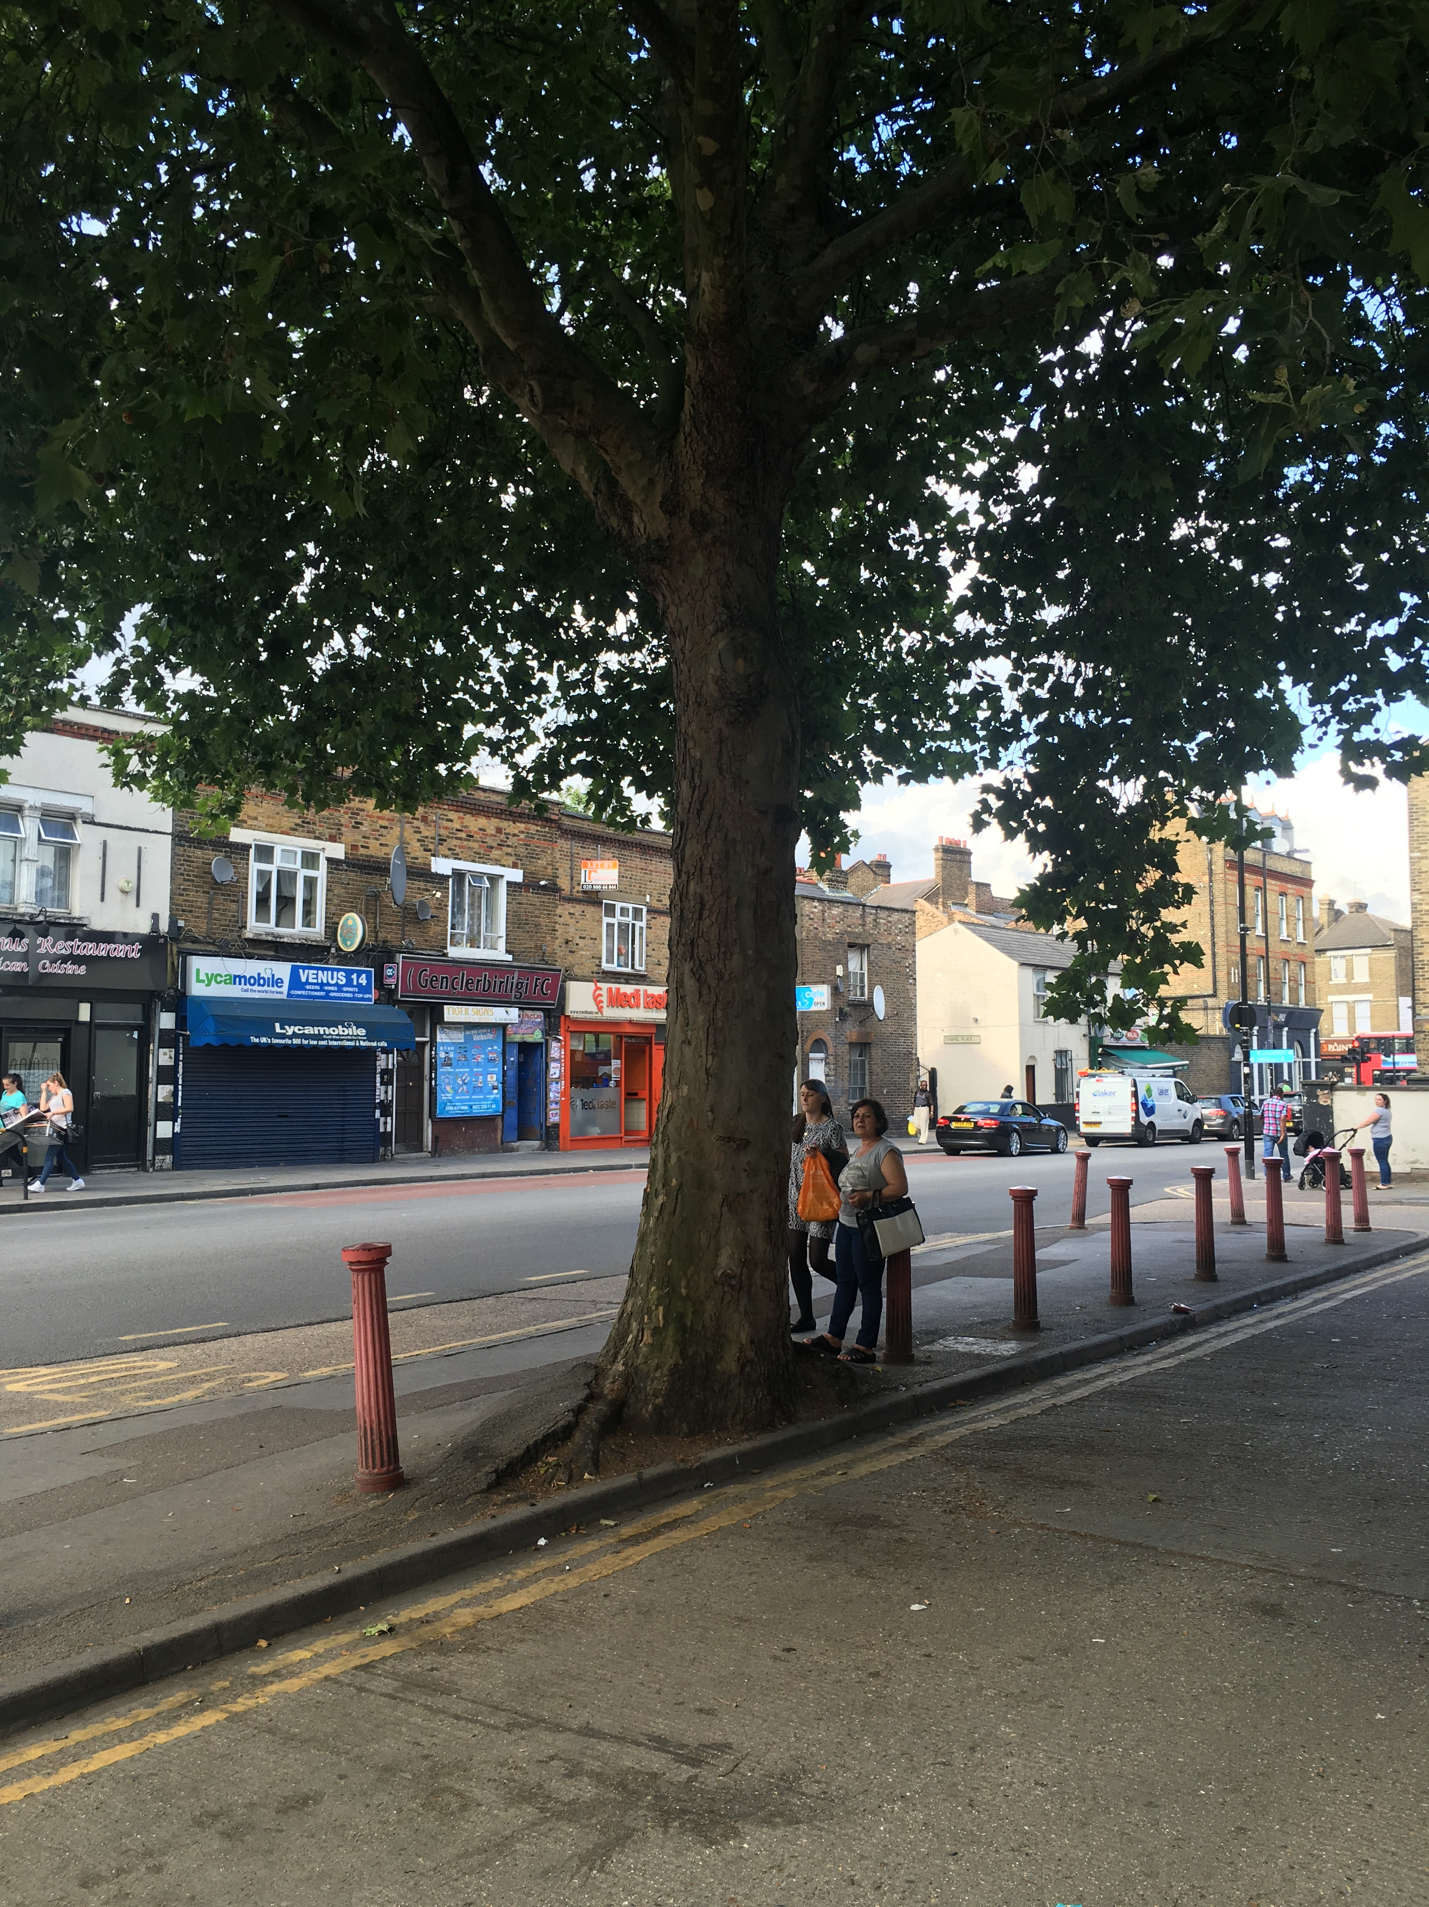
Integrating Street Trees, SuDS and Hard Landscapes
The SYNERGY between permeable surfaces and green infrastructure design.
  Permeable surfaces collect and clean runoff ‘at source’
  Clean water is delivered to green infrastructure every time it rains.
  ‘Passive collection’ requires no dedicated inlet devices or special maintenance.

Slide 7
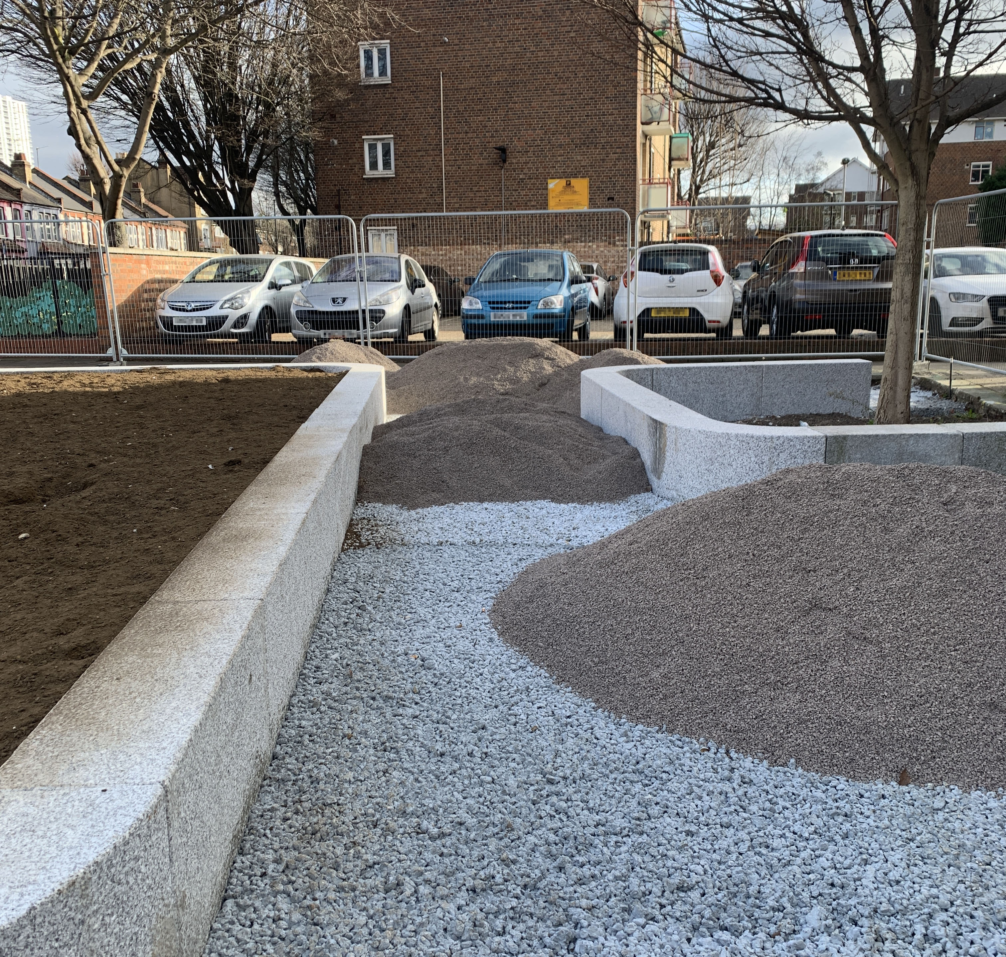
Integrating Street Trees, SuDS and Hard Landscapes
Raingarden and tree planting enhancement
  Everyday rainfall is captured for soil hydration during the summer.
  ‘Heat island’ effects are mitigated by evapotranspiration in summer.
  High-intensity summer rainfall is managed.
  Pollution is retained on pavements for regular removal as current ‘best practice’.
  Irrigation is available from above or below.

Slide 8
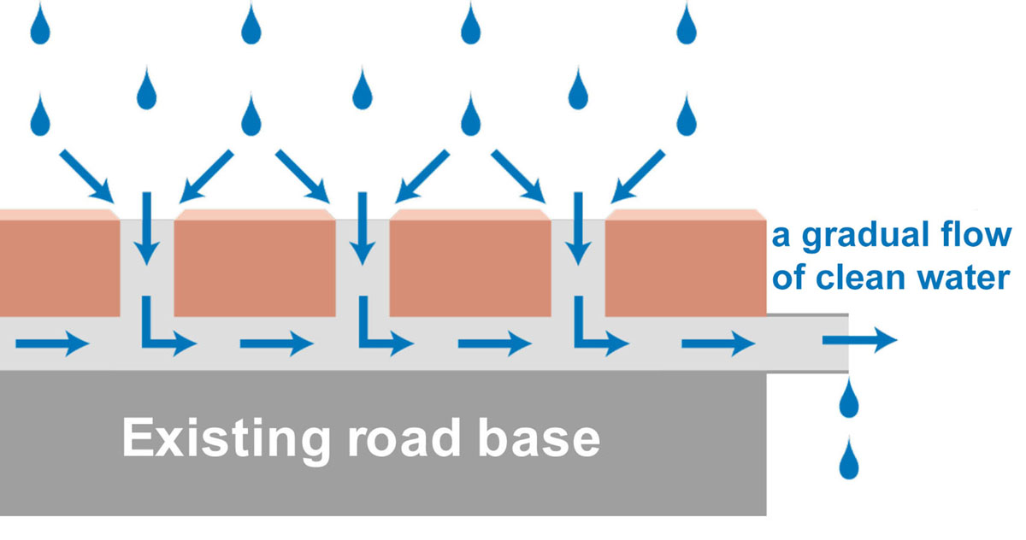
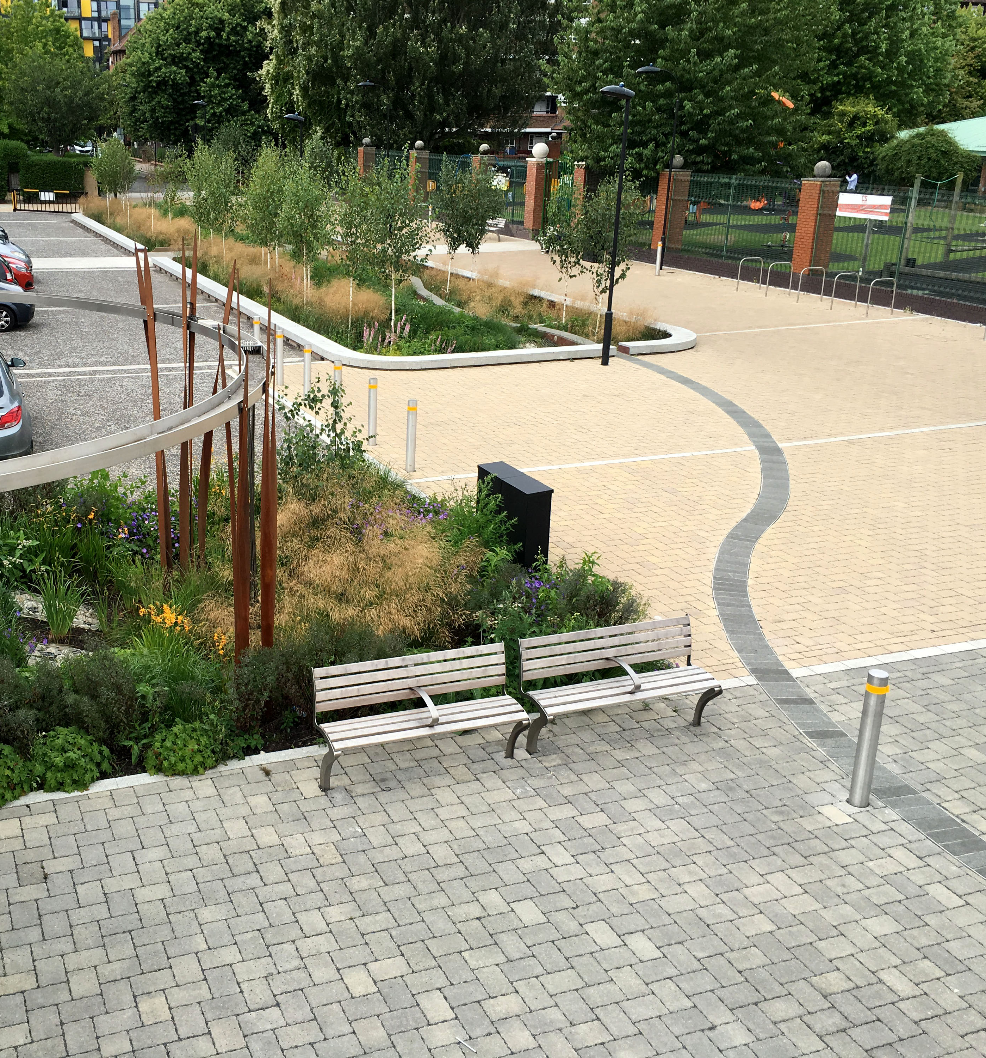
Integrating Street Trees, SuDS and Hard Landscapes
The permeable block ‘overlay’ principle
  Concrete block permeable paving on a 50mm bed of 2-6mm grit collects, cleans and stores up to 20mm of everyday rainfall for green infrastructure.
  This represents up to 95% of rainfall events. Overflows manage extreme rainfall.
  Lateral flows to trees, bioretention raingardens or greenspace for SuDS storage rehydrates the city landscape.
  Low-intervention, permanent alternative to regular asphalt renewals, re-using existing road base and embodied carbon.

Slide 9
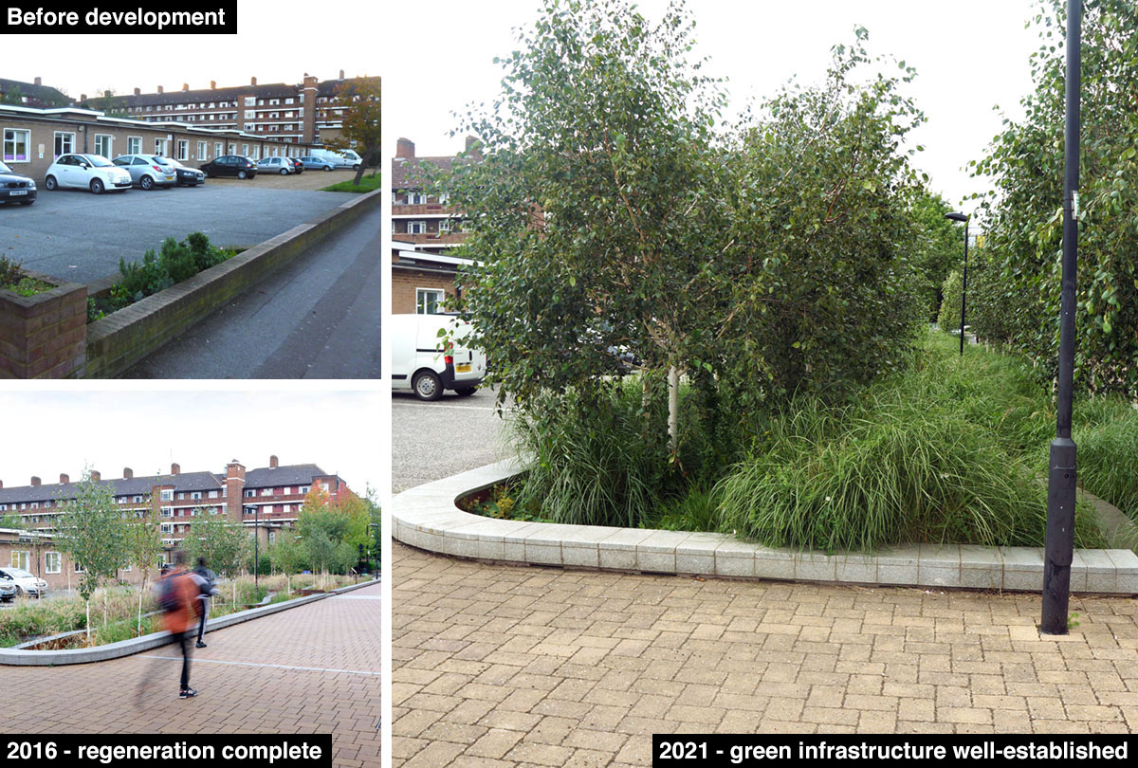
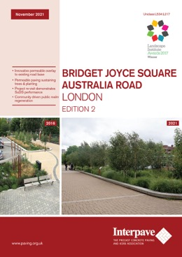
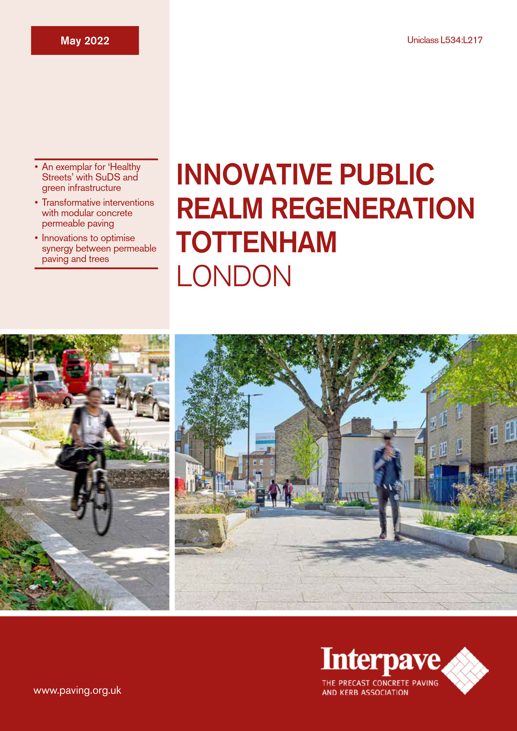
Integrating Street Trees, SuDS and Hard Landscapes
These relatively new technologies have now been used together in Britain with great results
  Bridget Joyce Square – the first overlay pavement still performing well after 5 years.
  Tottenham regeneration – delivering ‘Healthy Streets’ with SuDS and trees.
  Urban tree planting is now an established technique countrywide – but it needs permeable surfaces for long-term sustainable performance.
www.paving.org.uk

